Slide 1
Independent Study: Patent Data Visualization
By: Joe Dorris

Slide 2
Overview
Background
Database
Web framework
Comparing Patents
Conclusion

Slide 3
Patent Attorney
Lawyer with qualifications to represent clients in matters dealing with patents
File for patent
Appeal USPTO decision
Sue for infringement
Applicant needs engineering or scientific undergraduate

Slide 4
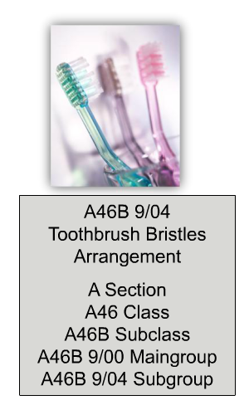
Intellectual Property
Intellectual Property
Trademark
Patents
Utility
Copyright
Design
Plant
Reissue
A- Human Necessities
B- Transporting
...
46B- Brushes
...
Notes:
Trademarks- a sign that you can use to distinguish your business’s goods or services from other traders
Copyright- creator of an original work has exclusive rights to it
Patent- right granted by the government to an inventor, giving the owner the right to exclude others from making, using, and selling an invention in exchange for public disclosure of invention
Utility- the invention of a new and useful process, machine, manufacture, or composition of matter or improvement thereof…
20 years form patent application filling
Exclude others from making, using, or selling the invention
Design- new, original, and ornamental design applied ot an article of manufacture
Plant- invented or discovered asexually reproduced plant
Reissue- correct error in one of the other 3 which can change scope
Cooperative Patent Classification -2013

Slide 5
Patents
Greek city of Sybaris had them in 500 BCE.
First English patent was from King Henry VI in 1449 for how to make stained glass.
Granted him 20 year monopoly
+/-’s for inventor/society
Inventor gets protection from reverse engineering
Disclose how something is made to society
Only for limited amount of time
Notes:
https://en.wikipedia.org/wiki/History_of_patent_law

Slide 6
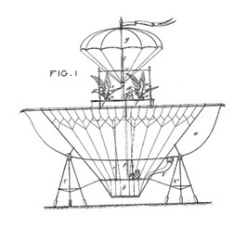
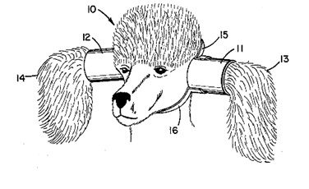
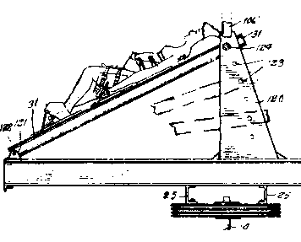
Patentability
Requirements:
New
Requires investigating to see if it is new
Useful
Non-obvious
Accompanied by a written description of how to make and use invention

Slide 7
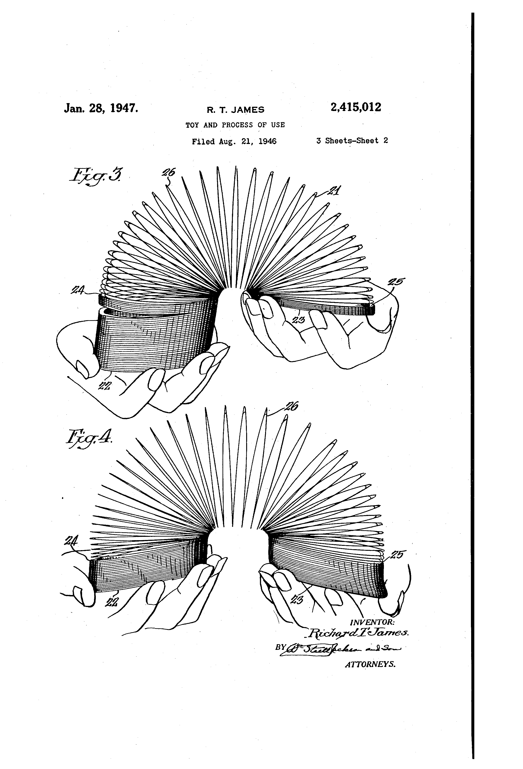
Prior Art Search
Sources
US and foreign patents
Journal articles
Conference proceedings
Websites
Etc.
Difficulties
Vague Terms / Synonyms
Toy and Process of Use = Slinky
Terms change over time

Slide 8
Number of Patents is Growing

Slide 9
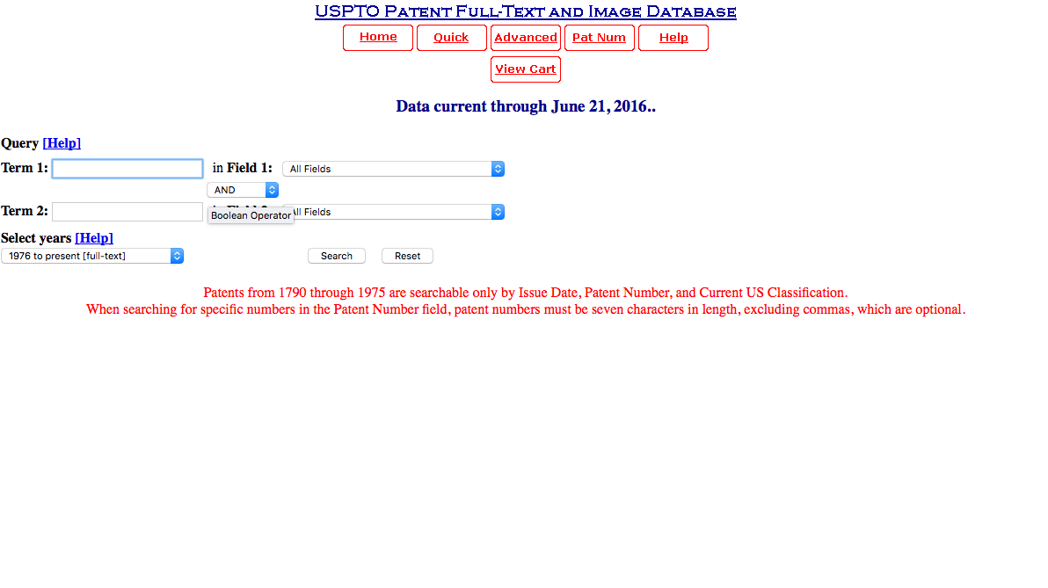
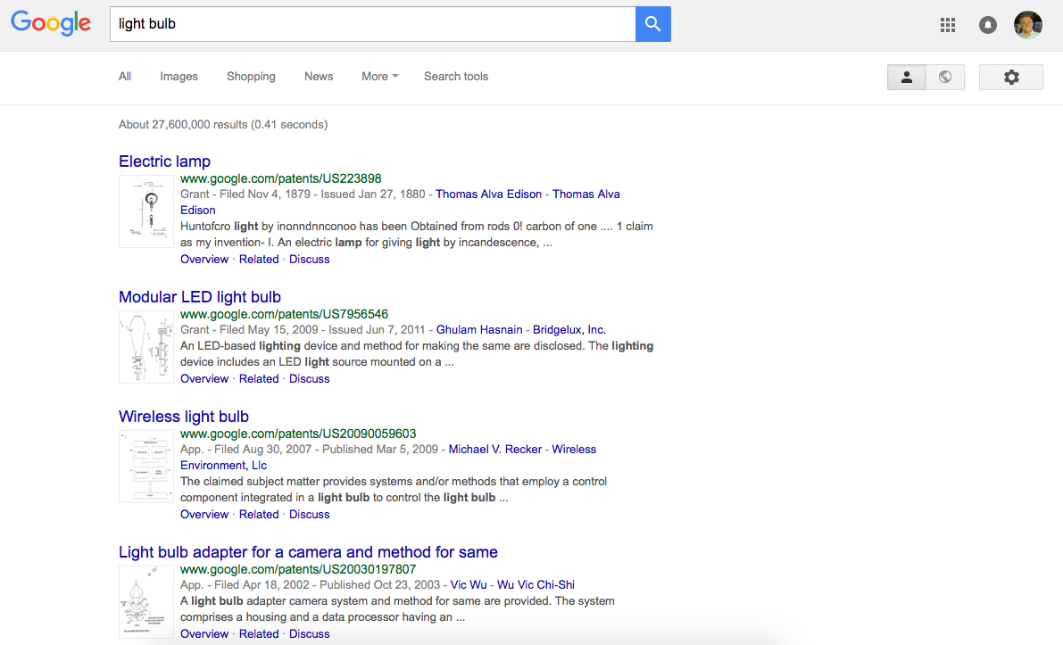
Current options for search

Slide 10
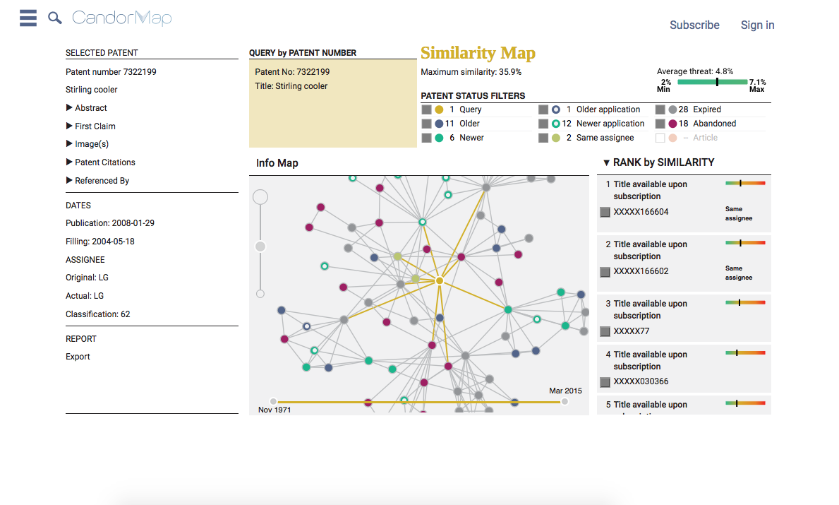
Current options for search
Notes:
www.candormap.com/

Slide 11
Goals for Class
Prepare for law school and patent law by working with patent data
Gain experience with unfamiliar topics
Website
Databases
Natural language processing
Engineer a final product

Slide 12
Overview
Background
Database
Web framework
Comparing Patents
Conclusion

Slide 13
Database Creation
MySQL
Fill database with bulk data from USPTO website that is in the form of XML files
Multiple scripts needed to parse XML and fill database
Tags change between years
Lots of data not important
Contained HTML

Slide 14
Database
Patent Info
Patent ID | Title | Publication Date | Inventor | Assignee | References | ReferencedBy | Topics | Similar
Patent Data
Patent ID | Abstract | Claims | Description | Images

Slide 15
Stats- Patent Assignees
Notes:
Top 2?
International Business Machines Corporation – 2830 patents
Samsung Electronics Co., Ltd. – 1875 patents

Slide 16
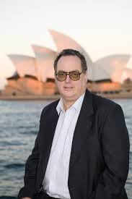
Prolific Inventors
Kia Silverbrook
143 patents in my subset
Silverbrook Research Pty Ltd
Actually has 4,665
Robotics to DNA analysis
Business Insider 2011- Best Inventor of the Modern Era

Slide 17
Referenced By List
If reference patent is in the database append to ref_by list
Patent ID | Title | Publication Date | Inventor | Assignee | References | ReferencedBy | Topics | Similar
1 |  |  |  |  | 2
2 |  |  |  |  |  | 1

Slide 18
Overview
Background
Database
Web framework
Comparing Patents
Conclusion

Slide 19
Server-side
Node.js- server
Express.js- framework
PUG- template engine
Website layout
Homepage for search/results
Dynamic page for patent interaction

Slide 20
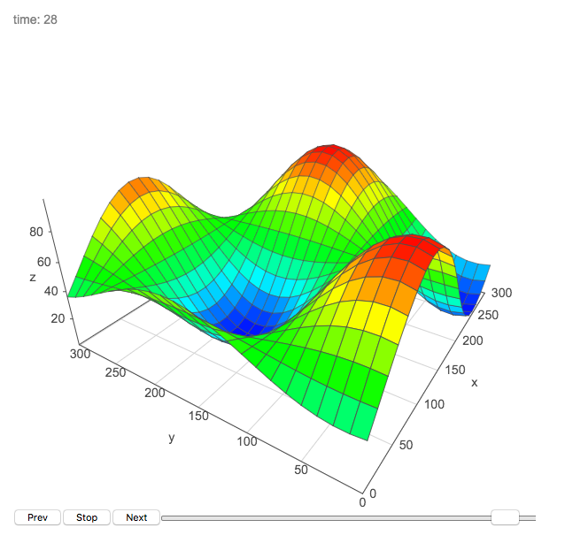
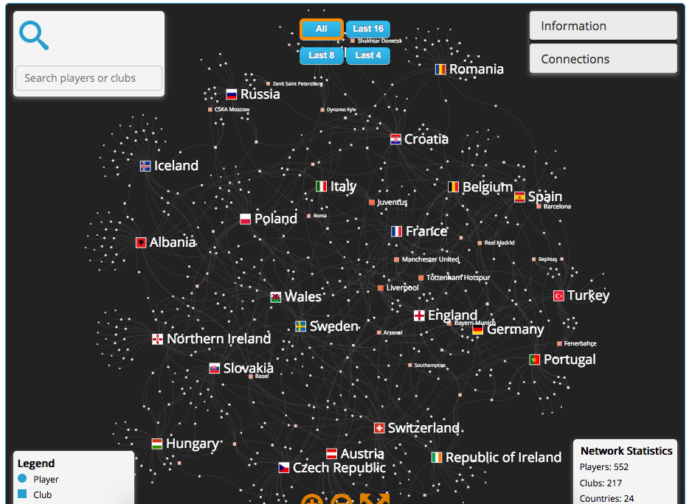
Client-side graphics
Vis.js- Dynamic browser based visualization library
Network graph
Nodes- patents
Edges
Reference
Similarity
etc.

Slide 21
Overview
Background
Database
Web framework
Comparing Patents
Conclusion

Slide 22
Tokenization
The quick brown Fox-man jumped over the lazy brown dog.
Punctuation
Capitalization
Stop words
Hyphenated words
Word frequencies
quick brown foxman jumped over lazy brown dog
[[quick, 1], [brown,2], [foxman,1], [jumped,1], [over,1], [lazy,1], [dog,1]]
Notes:
https://en.wikipedia.org/wiki/Bag-of-words_model

Slide 23
Stemming
SSES | -> | SS |  |  | caresses |  | -> |  | caress
IES | -> | I |  |  | ponies |  | -> |  | poni
 |  |  |  |  | ties |  | -> |  | ti
SS | -> | SS |  |  | caress |  | -> |  | caress
S | -> |  |  |  | cats |  | -> |  | cat
Included in NLTK
Porter Stemming
Set of rules – S1 -> S2 (If ends in S1 replace with S2)
Combine all tokens that are the same stem
Remove all single occurrence words
Notes:
http://snowball.tartarus.org/algorithms/porter/stemmer.html

Slide 24
Term-document Matrix
Term\DOC # | 1 | 2 | 3 |  | 100,000
voltage | 0 | 32 | 0 | …
imag | 0 | 23 | 0 | …
corn | 27 | 0 | 0 | …
…
174,804

Slide 25
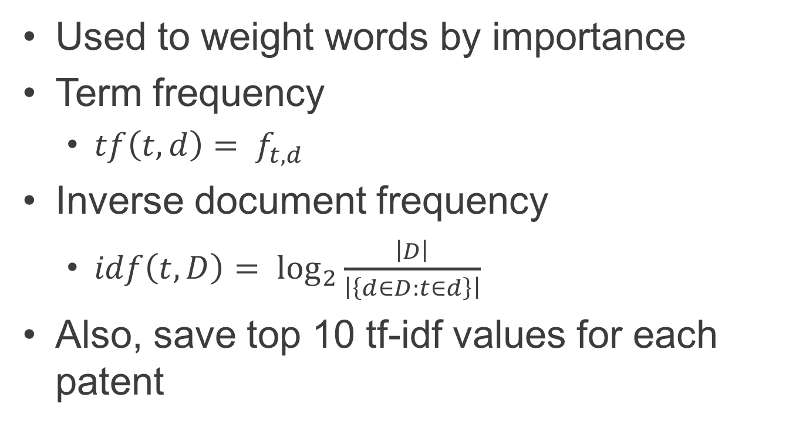
Term frequency- inverse document frequency
Used to weight words by importance
Term frequency
$tf\left(t,d\right)= f_{t,d}$
Inverse document frequency
$idf\left(t,D\right)= \log_{2}{\frac{\left|D\right|}{\left|\left\{d∈D:t∈d\right\}\right|}}$
Also, save top 10 tf-idf values for each patent
Patent ID | … | Topics | Similar
1 |  | Corn, …
2 |  | Voltage,

Slide 26

Latent Semantic Analysis
Dimensionality reduction for text
Reduce rows but preserve similarity structure
Reduces size and noise
Use tf-idf matrix and perform truncated SVD to perform PCA
Keep eigenvectors with highest eigenvalues (100-300)
Map data to new space
Notes:
http://stats.stackexchange.com/questions/134282/relationship-between-svd-and-pca-how-to-use-svd-to-perform-pca

Slide 27
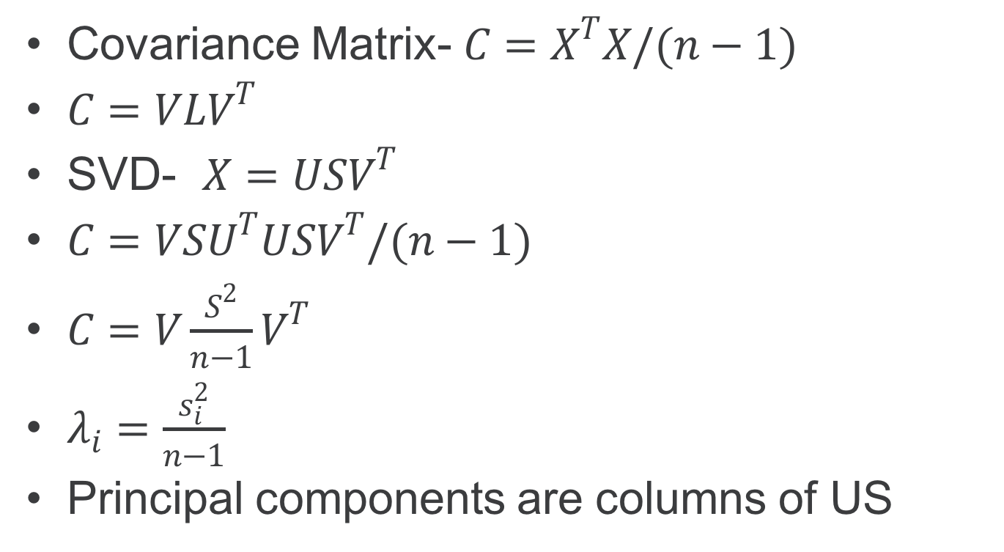
LSA
Covariance Matrix- $C=X^{T}X/(n−1)$
$C=VLV^{T}$
SVD- $X=USV^{T}$
$C=VSU^{T}USV^{T}/(n−1)$
$C=V\frac{S^{2}}{n−1}V^{T}$
$λ_{i}=\frac{s_{i}^{2}}{n−1}$
Principal components are columns of US

Slide 28
LSA Matrix
Topic\DOC # | 1 | 2 | 3 |  | 100000
.5 network + .19 messag + … | .006 | .03 | -.02 | …
.23 voltage + … | .04 | .9 | -.04 | …
.4 corn + .3 maize + … | .234 | .001 | .03 | …
…
300 topics

Slide 29
Recap of Data Flow
Text
Cut stop words/ remove punctuation etc
Word frequencies
Stems frequencies
Cut single occurrence
Tf-idf
LSA with 300 topics
10 GB to 100 MB

Slide 30
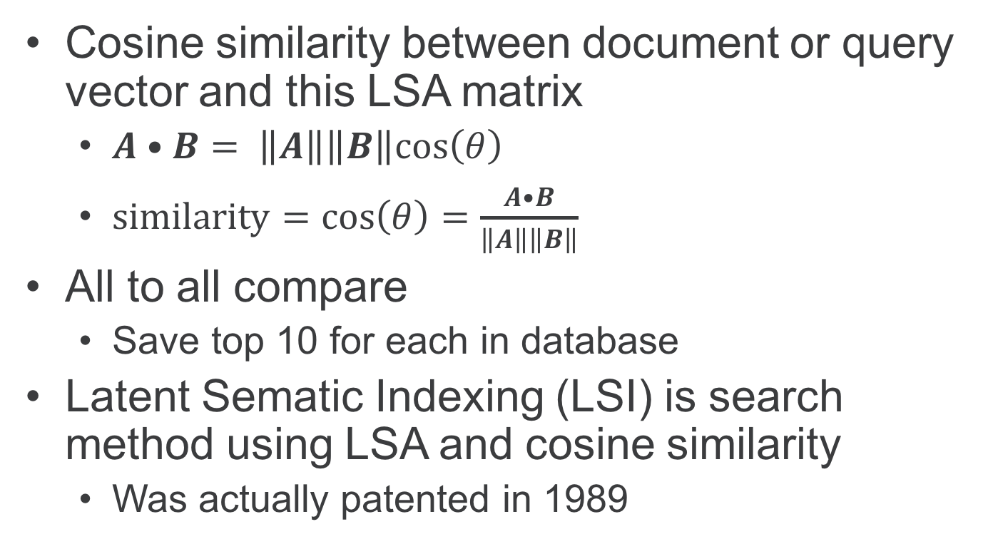
Comparing Documents
Cosine similarity between document or query vector and this LSA matrix
$A•B= \left\|A\right\|\left\|B\right\|cos\left(θ\right)$
$similarity=cos\left(θ\right)=\frac{A•B}{\left\|A\right\|\left\|B\right\|}$
All to all compare
Save top 10 for each in database
Latent Sematic Indexing (LSI) is search method using LSA and cosine similarity
Was actually patented in 1989
Patent ID | … | Topics | Similar
1 |  | Corn, … | 34, 27,…
2 |  | Voltage.. | 3, 76, ..

Slide 31

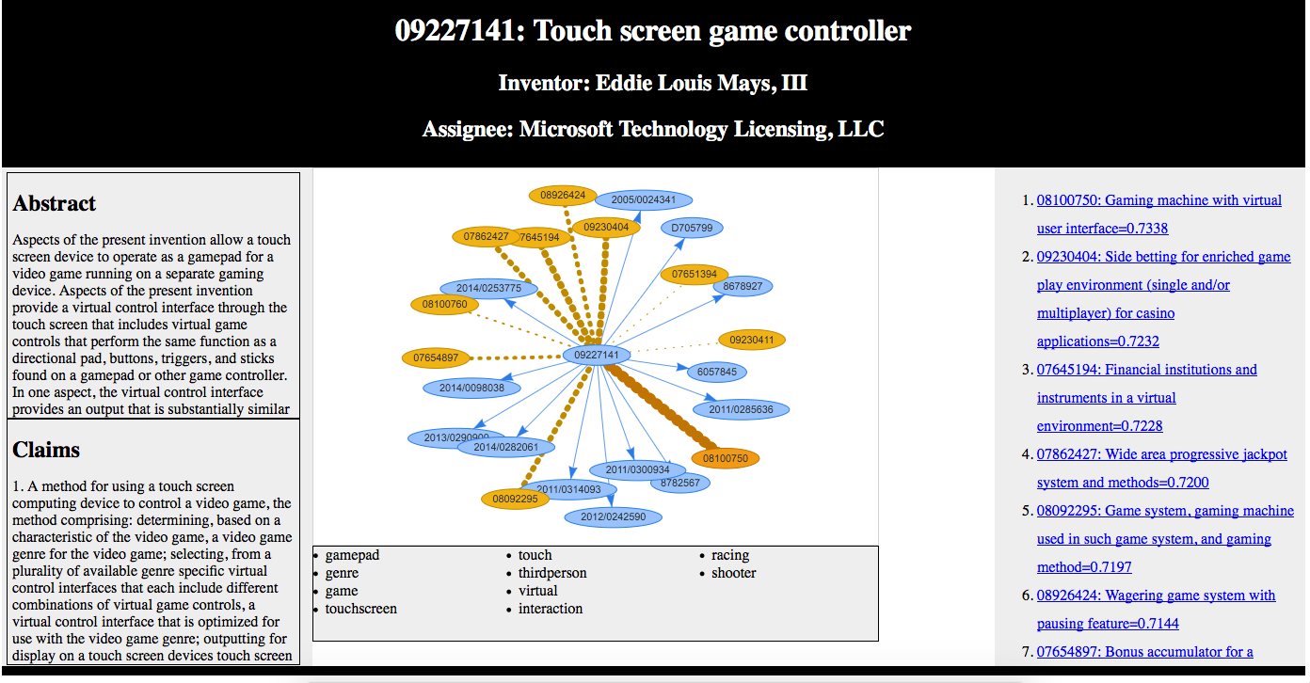
Final Product
http://localhost:3000/

Slide 32
Overview
Background
Database
Web framework
Comparing Patents
Conclusion

Slide 33
Learning Components
Patents
SQL
Javascript
Database Creation and Management
XML parsing
Web Server
Client side graphics
Natural language processing

Slide 34
Future Work
Direct comparison- overlapping sets of important words, different connections
All documents
Timeline/ expired patents
Show images if hover over it
Add traditional classification comparison
Click on important words
Wordnet
Clustering
Agglomerative
Notes:
https://joernhees.de/blog/2015/08/26/scipy-hierarchical-clustering-and-dendrogram-tutorial/
http://web.eecs.utk.edu/~qi/ece471-571/lecture17_clustering.pdf

Slide 35
THANK YOU ICL!!!

